Slide 1

Shall We Play a Game: Studying Human & Ransomware Interaction
CS-GY 9223: Security and Human Behavior
By Charles Thomas and Kevin Zhang

Slide 2
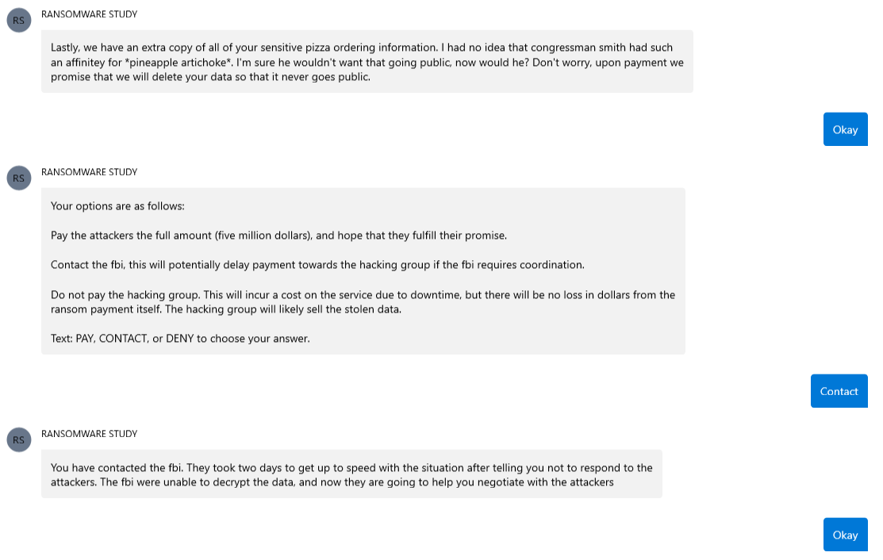
Example of the Game
CS-GY 9223: Security and Human Behavior
Ransomware difficult to understand from a human angle.
Game theoretic angle to understand decision making: is paying, negotiating, or denying a rational choice?
Deception: “Shall We Play a Game: Human Economics in the Security Space”

Slide 3
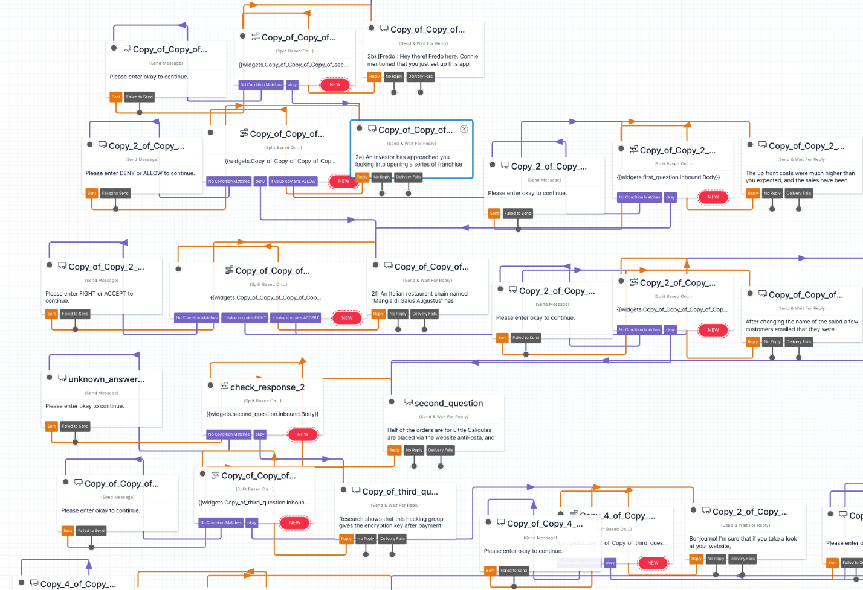
Twilio Backend
CS-GY 9223: Security and Human Behavior
108 Nodes:
3 Varied Endings:
Data Collected:
Choices Made
Final Dollar Amount
Time Spent Completing Game
Average Time Spent on Question
User Rationality (Questions Answered)
User sentiments (Debrief)
Results - Still gathering subject data

